Slide 1
CSDS_a
Functional Requirements – DEMO: 17 April 2015

Slide 2
OVERVIEW
CSDS provides middle level integration team with data from LDAP
Does not modify anything on LDAP
Simply read the database and returns data
Thus no UI needed

Slide 3
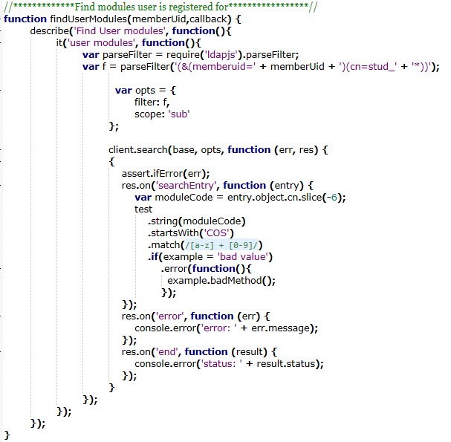
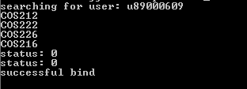
Code & Results: findUser
Print screen here

Slide 4
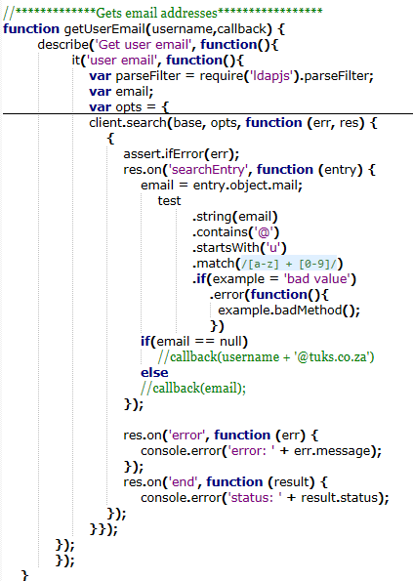

CCode & Results: GetEmail

Slide 5
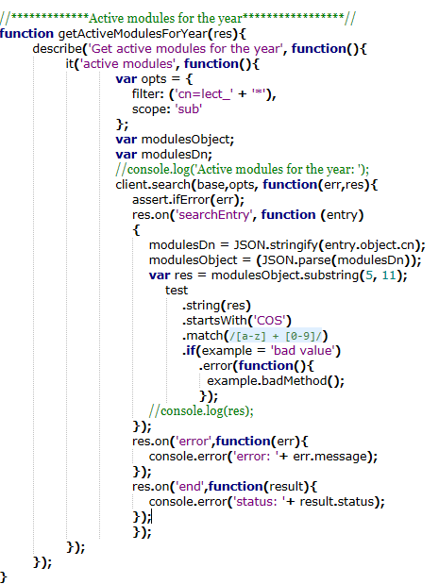
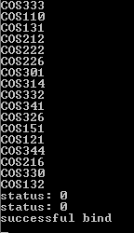
Code & Results: ActiveModules
Print screen here

Slide 6
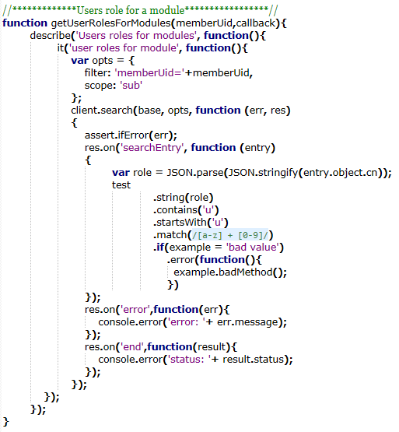
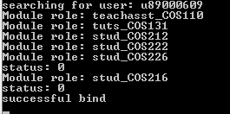
Code & Results: UserRoleForModule
Print screen here

Slide 7
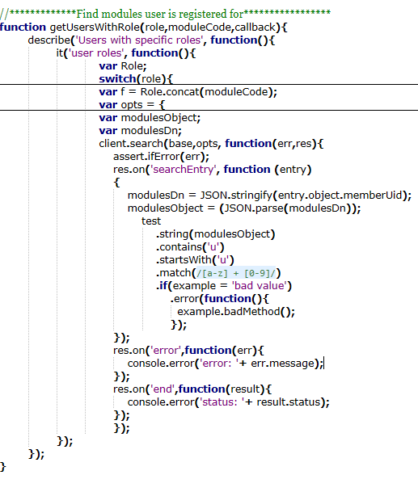
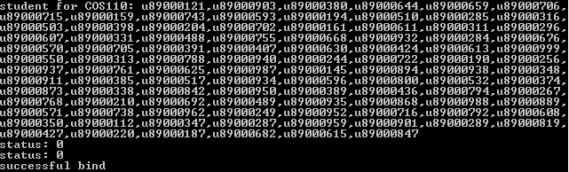
Code & Results:UserRoleForSpecific

Slide 8
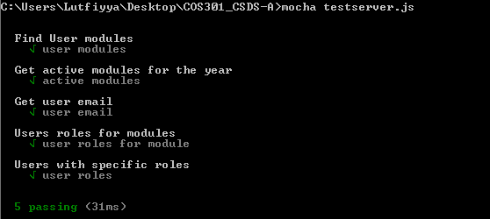
Unit Test
Screens shot here

Slide 9
Challenges faced with Code
Due to the asynchronous nature of node.js and the ldapjs API we have had great difficulty in returning the data required even though we were able to access the data from ldap successfully.
Failure to bind LDAP

Slide 10
Challenges faced with Mid-level
Time pleasure
Impossible to meet demands, ask for information that we could not retrieve from LDAP

Slide 11
Solutions
Got help from Lecton
In the end we managed a partial work around by passing callback functions into our functions which then handle the data we retrieve from LDAP

Slide 12
What we learned
Team work is crucial
Dependency injection is best
Time management is very important
Breakdown in communication results in unproductive use of time and thus communication is crucial

